Slide 1
Software
Maintenance

Slide 2
OBJECTIVES
To appreciate need of Software maintenance performed.
To understand reasons for change taking place in a software system.
To appreciate the concept of legacy system.
To know Software maintenance prediction.
To list various factors which adversely affect software maintenance.
To know types of software maintenance, viz. corrective, adaptive, perfective, and preventive maintenance.
To understand the Software maintenance life cycle.

Slide 3
OBJECTIVES
To know various software maintenance models, viz. quick-fix, iterative enhancement and reuse model.
To understand various techniques for maintenance, such as configuration management, impact analysis and software rejuvenation.
To list various tools that assist in maintaining the software.
To appreciate need for technology change management, which is a process of identifying, selecting and evaluating new technologies.
To understand software maintenance documentation.
Notes:
Rejuvenation - reconstruction

Slide 4
CONTENTS
Basics of software maintenance
Types of software maintenance
Software maintenance life cycle
Software maintenance Models
Techniques for maintenance
Tools for Software maintenance
Technology change management(TCM)
Software maintenance documentation

Slide 5
Definitions
Evolution - a process of continuous change from a lower, simpler, or worse to a higher, more complex, or better state.
Maintainability - the ease with which maintenance can be carried out.
Maintenance - the act of keeping an entity in an existing state of repair, efficiency, or validity; to preserve from failure or decline.
Software - the programs, documentation and operating procedures by which computers can be made useful to man

Slide 6
BASICS OF SOFTWARE MAINTENANCE
IEEE definitions
A process of modifying a software system or component after delivery to correct faults, to improve performance or other attributes, or to adapt the product to a changed environment.
In software engineering a software needs to be ‘serviced’ so that it is able to meet the changing environment (such as business and user needs) where it functions this servicing of software.

Slide 7
Some IEEE Definitions
the bug-fixing view - maintenance is the detection and correction of errors,
the need-to-adapt view - maintenance is making changes to software when its operational environment or original requirement changes,
the user-support view - maintenance is the provision of support to users.

Slide 8
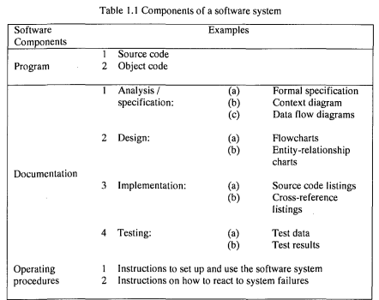
McDermid's definition of a Software System

Slide 9
Why Software Maintenance is Needed
Providing Continuity of Service
Fixing errors, recovering from failures, such as hardware failures or incompatibility of hardware with software, and accommodating changes in the operating system and the hardware. (Example: S/w controlling flight or train)
Supporting Mandatory Upgrades
Due to changes in government regulations (Ex: changes in tax laws) or need to maintain competition with other software that exist in the same category.

Slide 10
Improving the Software to Support User Requirements
To enhance functionality in a software for better performance. Also requirements for customization to local working patterns.
Facilitating Future Maintenance Work
Include restructuring of the software code and database used in the software.
It is financially and commercially justifiable to initiate change to make future maintenance easier.

Slide 11
Software Maintenance Framework
The context and environment in which software maintenance activities are carried out.

Slide 12
Components of Software Maintenance Framework
Components | Features
User requirements | Request for additional functionality, error correction, capability and improving maintainability. Request for non-programming related support.
Organizational Environment | Change in business policies. Competition in the market.
Operational Environment | Hardware innovations Software innovations.

Slide 13
Components of Software Maintenance Framework
Components | Features
Maintenance Process | Capturing requirements Creativity and undocumented assumptions Variation in programming practices. Paradigm shift. ‘Dead’ paradigms for ‘living’ systems. Error detection and correction.
Software Product | Quality of documentation. Complexity of programs. Program Structure Malleability of programs. Maturity or difficulty of application domain.
Maintenance personnel | Staff turnover. Domain expertise.

Slide 14
Relationship between the Maintenance Factors (3 major types)
Relationship between Software product and Environment
Relationship between Software product and
User
Relationship between Software product and Software Maintenance personnel
Software Maintenance team

Slide 15
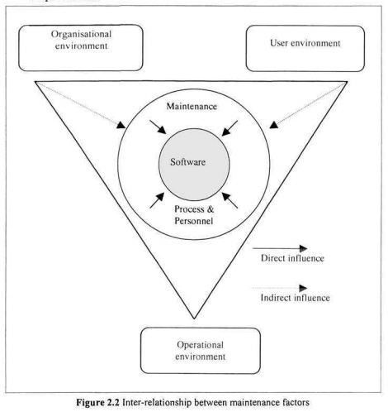
"The software is embedded in a cultural matrix of applications, laws and machine vehicles. These all change continually, and their changes inexorably force change upon the product. "
Notes:
Inexorably - unavoidably

Slide 16
Software Maintenance Team:
Various functions performed by the Software Maintenance team are:
Locating information in system documentation
Keeping system documentation up-to-date
Extending existing functions to accommodate new or changing requirements
Adding new functions to the system
Finding the source of system failures or problems
Managing change to the system as they are made.
The aspects of a maintenance team that lead to high maintenance costs are:
Staff turnover
Domain expertise

Slide 17
Software Change
Classification of Changes
Corrective
Adaptive
Perfective
Preventive

Slide 18
Types of SOFTWARE CHANGE
Corrective Change is modification initiated by defects in the software. A defect can result from design errors, logic errors and coding errors.
Adapting Change is initiated by moving the software to a different hardware or software platform – compiler, operating system or new processor.
Perfective change is to expand the existing requirements of a system. Example: providing a Management Information System with a data entry module or a new message handling facility.
Preventive maintenance is to prevent malfunctions or to improve maintainability of the software. (making programs easier and hence making future maintenance easier). Example: code restructuring, code optimization and documentation updating).

Slide 19
Types of SOFTWARE CHANGE
Corrective maintenance is concerned with fixing reported errors in the software.
Adapting maintenance means changing the software to some new environment, such as adapting a new version of an operating system.
Perfective maintenance involves implementing new functional or non-functional requirements.
Preventive maintenance involves implementing, changes to prevent occurrence of errors.
Notes:
corrective (due to defects); adaptive (due to changes in its
environment); perfective (to accommodate new requirements); and
preventive (to facilitate future maintenance work).

Slide 20
Categorizing Software Change
software change may be classified under the following categories:
Modification initiated by defects in the software.
Change driven by the need to accommodate modifications in the environment of the software system.
Change undertaken to expand the existing requirements of a system.
Change undertaken to prevent malfunctions.

Slide 21
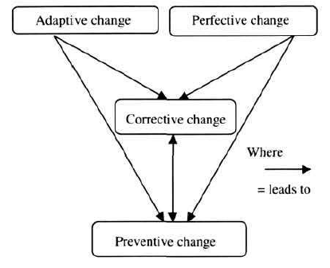
Potential Relation between Software Changes

Slide 22
Case Study - The Need to Support an Obsolete System
At the research institute attached to the ACME Health Clinic, the payroll system was computerised in the 1960's. The maximum salary with whichFundamentals of Software Change 41the system could cope was a factor of hardware and memory restrictions.There was no allowance for salaries above this maximum. Should acalculation yield a higher figure, the number would 'flip over' andbecome a large negative number. After a decade of inflation thismaximum salary, which had been considered far above the amount towhich the senior director could aspire, was barely above the averagestarting salary for a technician. A firm of consultants was called in andgiven two tasks. One was to develop a new up-to-date system and theother was to see that all wages were paid correctly and on time.This situation demonstrates the different priorities that can facesoftware maintainers.
The long-term solution was obviously thedevelopment of the new system. The upkeep of the old system was, in asense, a dead-end task. The system, no matter how much resource wasput into it, would be taken out of service at the first possible opportunity.In fact, resource given to the old system was resource taken from the newone and would delay implementation. Despite this, top priority had to begiven to keeping the old system running and producing accurate resultsup to the moment that the new system was up and running and wellenough tested to be relied upon.
The balance to be struck was the expenditure of as little aspossible resource on the old system while giving adequate resource to thedevelopment of the new; too little resource and wages would not be paid;too much and the project would run out of money before the new systemwas ready.The consultants did their job, all wages were paid on time andthe new system ran relatively smoothly for many years until supersededby new advances in both hardware and software technology.

Slide 23
Ongoing Support
essential for successful communication of desired changes.
The objectives include
Effective communication between maintenance and end-user personnel,
training of end-users
providing business information to users and their organizations to aid decision making

Slide 24
Legacy Systems
Were developed before the introduction of structured programming .
Process models and basic principles such as modularity coupling, cohesion, good programming practice emerged too late for them.
Legacy system are generally associated with high maintenance costs.
The root cause of this expense is the degraded structure that results from prolonged maintenance.

Slide 25
Legacy System Characteristics
Characteristics | Description
High maintenance cost | Results due to combination of other system factors, such as complexity, poor documentation and lack of inexperienced personnel.
Complex software | Results due to structural degradation, which must have occurred over a legacy system’s lifetime of change.
Obsolete support software | Support software may not be available for a particular platform, or no longer be supported by its original vendor or any other organization.
Obsolete hardware | Legacy system’s hardware may have been discontinued.

Slide 26
Legacy System Characteristics
Characteristics | Description
Lack of technical expertise | Original developers of a legacy system are unlikely to involved with its maintenance today.
Business critical | Many legacy system are essential for the proper working of the organizations which operate them.
Poorly documented | Documentation is often missing or inconsistent.
Poorly understood | As a consequence of system complexity and poor documentation, software maintainers often understand the legacy system poorly.

Slide 27
Changing a Software System
Software maintenance and evolution of system was first introduced by Lehman.
One of the key observations of the studies was that large system are never complete and continue to evolve and as these system evolve, they become more complex unless some actions are taken to reduce the complexity.
Lehman stated five laws for software maintenance and evolution of large systems.

Slide 28
Lehman Laws for software maintenance and evolution of large systems
Law | Description
Law of continuing change | A system is used in a real-world environment necessarily must change or become progressively less useful in that environment.
Law of increasing complexity | As an evolving system changes, its structure tends to become more complex. Extra resources must be devoted to preserving and simplifying the structure.
Law of self regulation | Global E-type system evolution processes are self-regulating, and distribution of product and process measures close to normal.
Law of conservation of organizational stability | Over a systems’s lifetime, its rate of development is approximately constant and independent of the resources devoted to system development.

Slide 29
Lehman Laws for software maintenance and evolution of large systems
Law | Description
Law of conservation of familiarity | For E-Systems to efficiently continue to evolve a deep understanding of how the system functions, and why it has been developed to function in that manner, must be preserved at all costs. The incremental change in each release over the life time of the system is approximately constant.
Law of continuing growth | E-type system’s functional capability must be continually enhanced to maintain user satisfaction over system lifetime. The requirements will trigger future demand for change. So the system growth is driven by feedback from its users.
Law of declining quality | Poorly modified systems lead to introduction of defects; & The quality of E-type systems will appear to be declining as newer products emerge.
Law of feedback systems | Evolution processes are multi-level, multi-loop, multi-agent feedback systems. To sustain continuous change or evolution, & to minimize threats of software decay & loss of familiarity, feedback to monitor the performance is must. Feedback helps to collect metrics on the systems and maintenance effective performance.

Slide 30
Economic Implications of Modifying Software
Resources expended for the maintenance of legacy software systems

Slide 31
Limitations for Software Change
Resource Limitations
Lack of skilled and trained maintenance programmers, the lack of suitable tools and environment to support their work, and lack of sufficient budget allocation.
Quality of the Existing System
In 'old' systems, quality can be so poor that any change can lead to unpredictable ripple effects and a potential collapse of the system.
This can lead to old systems (software and hardware), with huge maintenance costs, and provides less functionality.
Organizational Strategy
determinant of the size of a maintenance budget.
Inertia
The resistance to change by users may prevent modification to a software product.
Attracting and Retaining Skilled Staff
The high costs of keeping systems operational and ensuring that user needs are due to the problem of attracting and retaining highly skilled and talented software maintenance personnel (image problem).

Slide 32
The Nomenclature and Image Problems
The activities undertaken on existing software to keep it operational and acceptable to the users. These include
'software evolution‘ , 'post-delivery evolution'
and'support' .
Software evolution and post-delivery evolution - negative image

Slide 33
Potential Solutions to Maintenance Problems
Three approaches to maintenance problems:
(i) budget and effort reallocation - reassigning maintenance resources to develop more maintainable systems;
The use of more advanced requirement specification approaches, design techniques and tools, quality assurance procedures and standards such as the ISO 9000 series and maintenance standards are aimed at addressing this issue.
(ii) complete replacement of existing systems;
The risks and costs associated with complete system replacement are very high. Consider the factors Economic constraints, Residual errors in new systems, Database of information
(iii) enhancement (or maintenance) of existing systems.

Slide 34
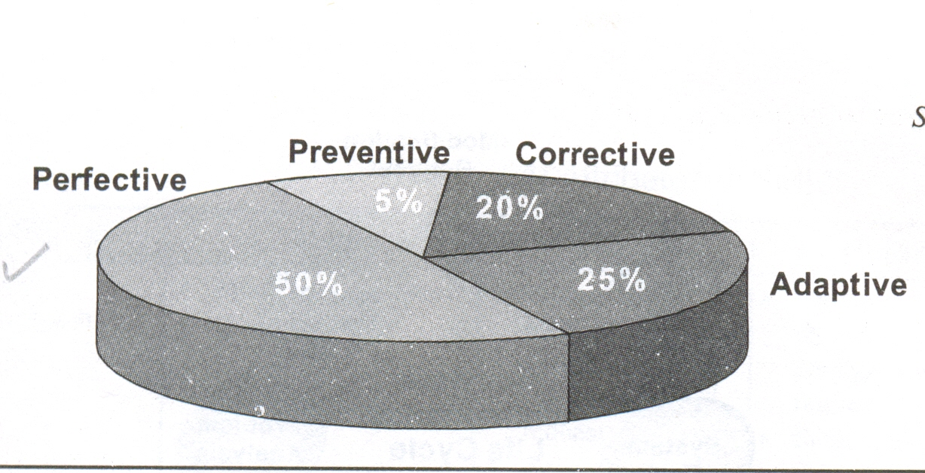
Expenditure on different Software Changes

Slide 35
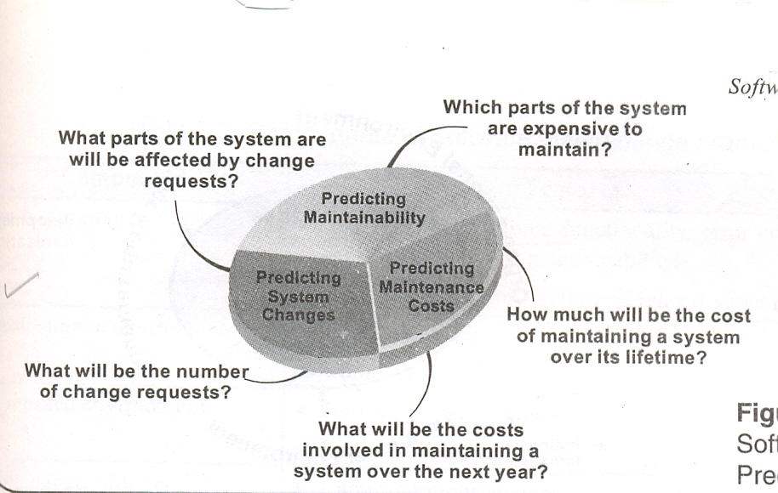
Software Maintenance Prediction

Slide 36
Software Maintenance Prediction
The various predictions shown in the figure are closely related and specify the following:
The decision to accept a system change depends on the maintainability of the system components affected by that change up to a certain extent.
Implementing change degrades the system structure and hence reduces its maintainability.
Costs involved in implementing change depend on the maintainability of system components.

Slide 37
Process metrics are used to predict software maintainability.
Some of the useful Process metrics are:
Corrective maintenance:
While fixing failures some times more errors are introduced rather than being repaired. This shows decline in maintenance.
Average time required for impact analysis:
The time that goes into analysis of impact of modifications before starting the software maintenance.
Number of outstanding change requests:
Increasing number of outstanding change requests with time implies decline in maintainability.
Average time to implement a change request:
If the time taken to implement the change in software and its documentation, rather than impact assessment, increases, it implies decline in maintainability.

Slide 38
The Maintenance Process
Definitions
Life-cycle - the cyclic series of changes undergone by an entity from
inception to 'death'. In terms of software, the life-cycle is the series of
recognized stages through which a software product cycles during its
development and use.
Model - the representation of an entity or phenomenon.
Process - the progress or course taken, methods of operation, a series of
actions taken to effect a change.
"A specific activity or action performed by a human being or machine during a software project“
Process model - the representation of the progress or course taken - i.e.
the model of the process.
Software maintenance process - the series of actions taken to effect
change during maintenance.

Slide 39
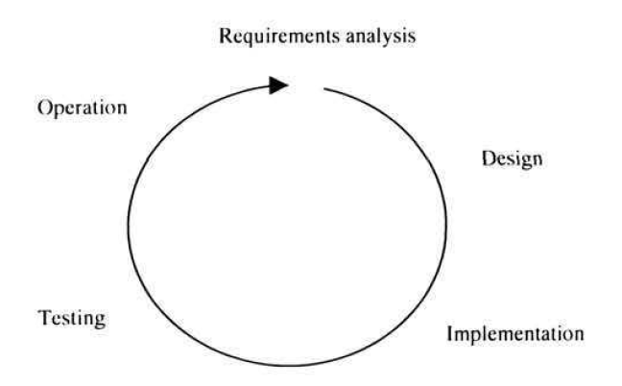
Generic Software Process Life-cycle (Evolution from Ad-hoc to Structured)

Slide 40
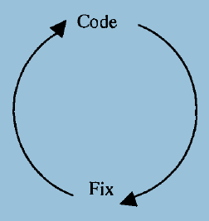
Process Models Code-and-Fix
ad hoc and not well defined. simple two-phase model
The first phase is to write code. The next phase is to 'fix' it.
Fixing in this context may be error correction or addition of further functionality.

Slide 41
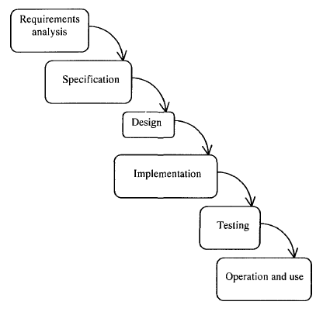
The Waterfall Model
Sequential
Decide what to do
Decide how to do it
Do it
Test it
Use it.

Slide 42
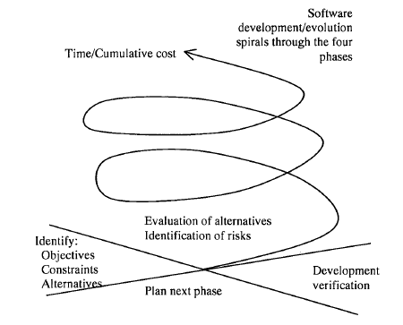
The Spiral Model
four-stage representation
At each level
objectives, constraints and alternatives are identified,
alternatives are evaluated, risks are identified and resolved,
the next level of product is developed and verified,
the next phases are planne

Slide 43
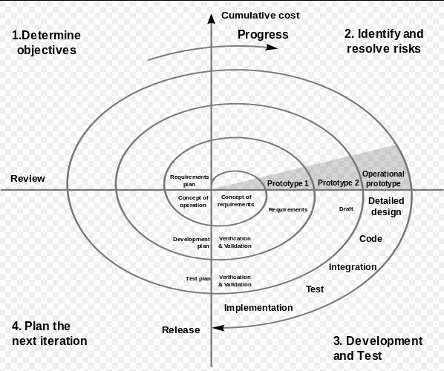
Spiral Model

Slide 44
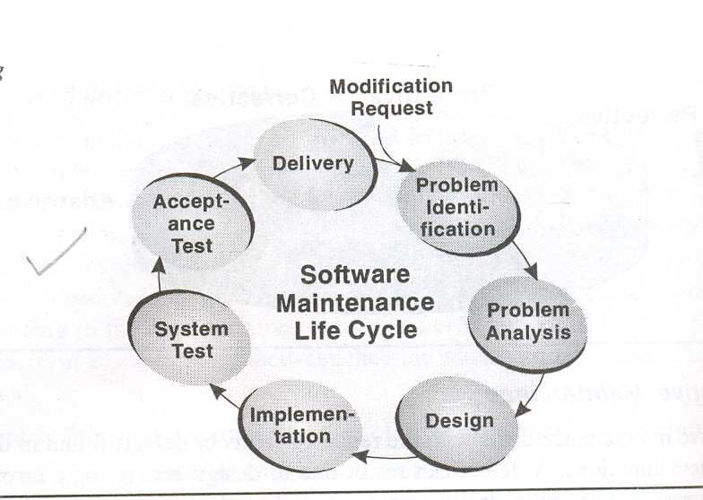
Phases of Software Maintenance Life Cycle

Slide 45
Attributes of Software Maintenance Life Cycle

Slide 46
Attributes of SMLC
Phases | Input | Process | Control | Output
Problem identification phases | Modification request | Assign change number Classify modification request Accept or reject change Prioritize | Uniquely identified modification request Enter modification request in repository | Validated modification request Validated Process determinations
Analysis phases | Project document Repository information Validated modification request | Feasibility analysis Detailed analysis | Conduct technical review Verify test strategy Verify whether the documentation is updated or not Identify security issues | Feasibility report Detailed analysis report Updated requirements Preliminary modification list Test strategy
Design phases | Project document Source code Databases Analysis phases output | Software test cases Revise requirements Revise implementation plan | Software inspections/ reviews Verify design | Revised modification list Revised detailed analysis Updated test plan

Slide 47
Phases | Input | Process | Control | Output
Implementa-tion phases | Source code System documentation Results of design phases | Software code Unit test Test preparation review | Software inspections/ review | Updated Software Updated design documents Updated test documents Updated user documents Test preparation review report
System test phase | Updated software documentation Test preparation review report Updated System | Functional test Interface testing Test preparation review | Software code listing Modification request Test documentation | Test system Test reports
Acceptance test phase | Test preparation review report Full integrated system Acceptance test plans Acceptance test cases Acceptance test procedures | Acceptance test Inter-operability test | Acceptance test | Acceptance test report
Delivery phase | Tested/ accepted system | Installation Training | Version description document | Version description document

Slide 48
SOFTWARE MAINTENANCE MODELS
Quick-fix model.
Boehm’s model
Osborne’s model
Iterative enhancement model.
Reuse-oriented model.

Slide 49
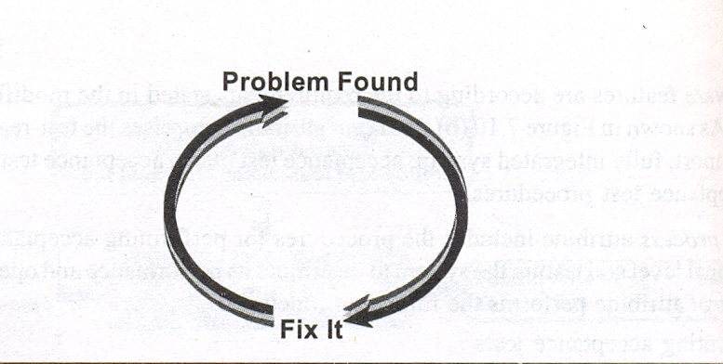
Identify problem & fix it as quickly as possible
No analysis of effects is made, and there is little or no documentation to use
Gets work done quickly with lower cost
In Quick-fix model starting point of maintenance is always source code.
Quick-fix Model

Slide 50
Case Study - Storage of Chronological Clinical Data
When the ACME Health Clinic system was originally developed, it catered only for a single recording per patient for things such as blood pressure, weight, medication and so on. This was because of a misunderstanding during requirements analysis which did not come to light until the system was in use. In fact, the system needed to store chronological series of recordings. At that stage, the need for storage of chronological data was immediate. The maintenance programmer assigned to the task drew up a mental model of data held in small arrays to allow speedy retrieval and proceeded to implement the change. This
quick-fix method identified the need
for the arrays,
to amend the data structures to allow for linking of the chronological data,
for a small restructuring program to modify the existing data.
There was no update of documentation, no documentation of the changes other than a few in-code comments and no in-depth analysis. Because this was done speedily as a quick fix, problems such as array overflow were not considered. In fact, once enough information was stored, data was going to 'drop off the end' of the arrays and disappear. This would lead to data corruption in that the chronological links would be broken and missing links would appear in the middle of the data chains (Figure 5.13).
This was noticed while another enhancement was being tested, the potential seriousness of the problem was recognised and the race was on to solve it before the clinic stored sufficient data to cause the problem.
This imposed yet another tight deadline and the fastest fix had to be found. The 'best' solution, a radical restructuring of the data and procedures for data retrieval and storage, was recognised, but could not be implemented because of the time restriction. Another quick fix had to be found. The only solution was to 'catch' data overflowing the temporary array and store it in the patient file. This meant that chronological links were maintained, but the data was being stored in the patient's file without being explicitly saved by the clinician. This not only led to less well-structured code, documentation further out of date and a situation even harder to retrieve, but was also in contravention of an original requirement regarding permanent saving of data.

Slide 51
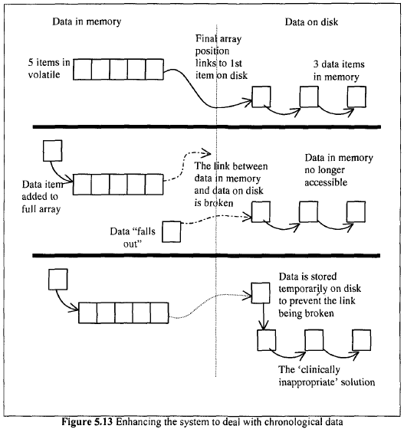
Case Study - Storage of Chronological Clinical Data ACME Health Clinic system

Slide 52
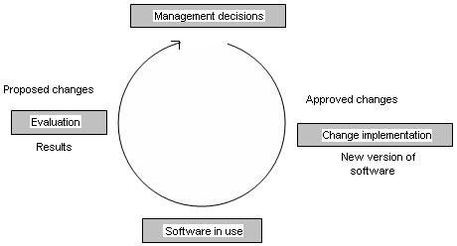
Boehm's model: Economic Model
Economic models and principles could not only improve productivity in maintenance but also help understanding of the process.
Maintenance process represented as a closed loop cycle
Management decisions (which are based on the balancing of objectives against constraints) are made that drives the process
In this stage, a set of approved changes is determined by applying particular
strategies and cost-benefit evaluations to a set of proposed changes
The approved changes are accompanied by their own budgets

Slide 53
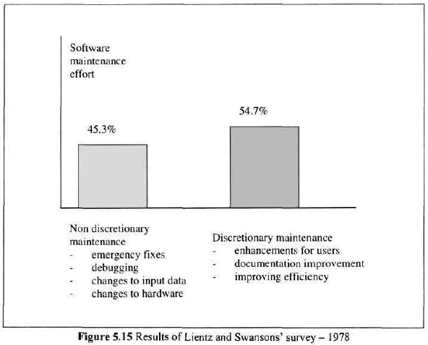
Note: Almost half maintenance effort was devoted to non-discretionary maintenance activities.

Slide 54
In terms of the production function - the economic relationshipbetween the inputs to a process and its benefits - this reflects the typicalthree-segment graph of;
1.Investment
2.High Payoff
3. Diminishing returns
CASE STUDY:
In the example of the problems with the ACME Health Clinic system, this approach to maintenance would have recognized that the quick-fix approach adopted was not appropriate. Had a quick fix been essential, it would have been a temporary holding measure which would have allowed the system to continue running without radical and ill thought-out changes. These would have been assessed as part of the overall strategy and would have allowed a progression towards the real solution instead of the inevitable path away from it.

Slide 55
Osborne’s Model
It deals directly with the reality of the maintenance environment, where as other models tend to assume some facet of an ideal situation – for example, the existence of full documentation.
The maintenance model is treated as continuous iterations of the software life-cycle with, at each stage, provision made for maintainability to be built in.
If good maintenance features already exist, for example full and formal specification or complete documentation, all well and good, but if not, allowance is made for them to be built in.

Slide 56
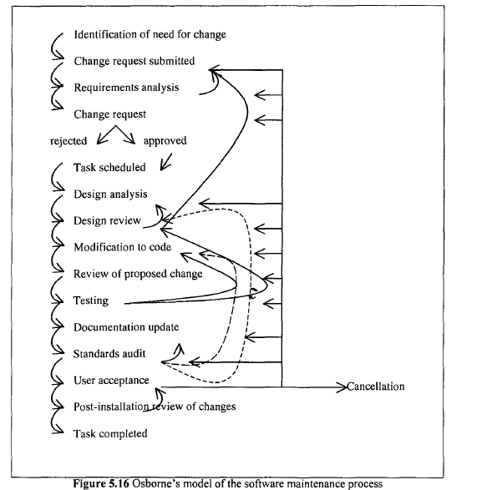

Slide 57
Osborne hypothesises that many technical problems which arise during maintenance are due to inadequate management communications and control, and recommends a strategy that includes:
the inclusion of maintenance requirements in the change specification;
a software quality assurance program which establishes quality assurance requirements;
a means of verifying that maintenance goals have been met;
performance review to provide feedback to managers

Slide 58
Iterative Enhancement Model
This model requires complete documentation as starting point of each iteration
Analyze Existing System
Characterize Proposed Modifications
Redesign Current Version & Implement
It is similar to evolutionary development paradigm
It is a three stage cycle

Slide 59
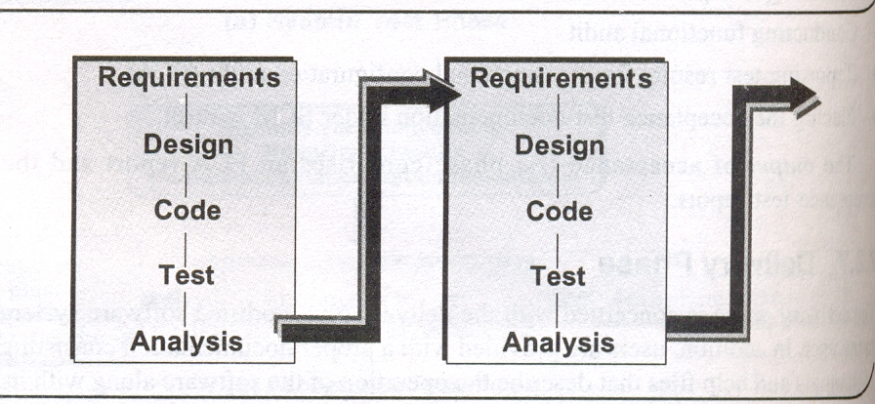
Iterative Enhancement Model

Slide 60
the implementation of changes to a software system throughout its lifetime is an iterative process (enhancing the system in an iterative way.)
Suited for the environment where requirements were not fully understood and a full system could not be built.
The model is effectively a three-stage cycle
Analysis.
Characterization of proposed modifications.
Redesign and implementation.
The existing documentation for each stage (requirements, design, coding, testing and analysis) is modified starting with the highest-level document affected by the proposed changes.
These modifications are propagated through the set of documents and the system redesigned.

Slide 61
The model supports reuse and also accommodates other models, for example the quick-fix model.
A quick fix may be carried out, problem areas
identified, and the next iteration would specifically address them.
The problems with the iterative enhancement model stem from assumptions made about the existence of full documentation and the ability of the maintenance team to analyse the existing product in full.

Slide 62
Reuse-Oriented Model
Maintenance is viewed as the activity involving the reuse of existing program components.
A detailed framework is required for the classification of components and the modifications for reuse.
The starting point may be any phase – the requirements, the design, the code or the test data.

Slide 63
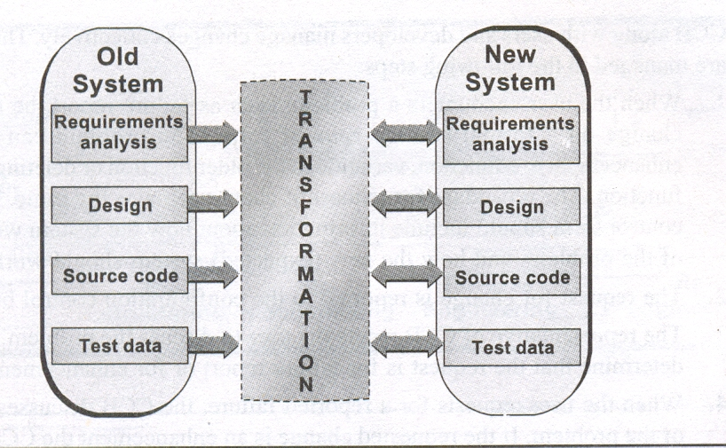
Reuse-oriented Model
Component Library

Slide 64
The Reuse Model has 4 main steps:
Identification of the parts of the old system which have the potential for reuse,
Fully understanding these system parts,
Modification of the old system parts appropriate to the new requirements, and
Integration of the modified parts into the new system.

Slide 65
PROGRAM UNDERSTANDING
Unit-1

Slide 66
Program Understanding
Role of program understanding during maintenance activities:
having the knowledge of what the software system does and how it relates to its environment
identifying where in the system changes are to be effected, and
having an in-depth knowledge of how the parts to be corrected or modified work.

Slide 67
Issues in Program Understanding
consumes a significant proportion of maintenance effort and resources.
At Hewlett Packard it was estimated that reading code (a fundamental element in comprehension) costs $200 million a year .
half of the total effort expended on understanding programs.
This expenditure tends to increase due to programs of inaccurate, out-of-date or even non-existent system documentation, or of deterioration in program structure due to several years of ad hoc quick fixes.

Slide 68
Understanding during maintenance
.
1. Bottom-up - working from the detail to the general overview – starting with small detailed constituents and building them up into larger aspects.
2. Cause-effect relation - This is the causal relation between a consequence and those parts of the program that brought it about .
3. Chunking - The process of putting together small units of information(such as program statements) into larger units (such as procedures) Each of these information units is known as a chunk.
4. Cognitive process - how the knowledge is manipulated in human memory during the formation and use of mental models.
5. Cognitive structure - the way in which knowledge is stored in human memory.
6. Comprehension - understanding, the capacity to understand general relations of particulars.
7.Decision-support feature - An attribute of a software product that can guide maintenance personnel in technical and management decision making processes.
8. Execution effect - The behaviour of the system when it is run.

Slide 69
Understanding during maintenance
9. Functional requirements - statements of the services that a system should provide.
10. Mental model - an abstract representation of an entity.
11. Non-functional requirements - constraints on the services and functions offered by a system.
12. Opportunistic - taking advantage of favourable circumstances as they arise.
13. Problem domain - The problem is the task being performed by the software and the problem domain is the area to which the task belongs.
14. Product-environment relation - This is the connection between the whole system and elements of the sphere within which it operates.
15. Top-down - working from the general to the specific - starting with large general aspects and breaking them down into smaller more detailed constituents.
16. Vocabulary problem - The difficulties that arise from the use of identifier names that fail to convey the intended meaning

Slide 70
Aims of Program Comprehension
The ultimate purpose of reading and comprehending programs is to be able successfully to implement requested changes.
This entails acquiring information about certain aspects of the software system such as
1.problem domain
2. execution effect
3.cause-effect relation
4.product-environment relation
5.decision-support features of the software

Slide 71
1. Problem domain
To direct the maintenance personnel in the choice of suitable algorithms ,methodologies, tools and personnel
Example
A compiler, for example, consists of elements such as a parser; lexical analyzer and code generator, each of which can be decomposed into even smaller components. In order to effect change or simply to estimate the resource required for a maintenance task, knowledge of the problem domain in general and the sub-problems in particular is essential.
Selection of personnel with the appropriate level of expertise and skills
Information can be from various resources – the system documentation, end-users, or the program source code.

Slide 72
2. Execution effect
To determine whether or not a change did achieve the desired effect
At a high level of abstraction, the maintenance personnel need to know
what results the program will produce for a given input without knowing which program units contributed to the overall result or how the result was accomplished.
At a low level of abstraction, they need to know the results that individual program units will produce on execution.
Knowledge of data flow, control flow and algorithmic patterns can facilitate the accomplishment of these goals
Example
a specialist compiler programmer may want to know, at a higher level of abstraction, the output from a complete compilation process, and at a lower level, the output from the parser. During maintenance, this information can assist the maintenance personnel to determine whether an implemented change achieved the desired effect.

Slide 73
3. Cause-effect relation
Establish the scope of a change, to predict potential ripple effects and to trace data flow and control flow
In large and complex programs, this relation is important as follows:
It allows the maintenance personnel to reason about how components of a software product interact during execution.
It enables a programmer to predict the scope of a change and any
knock-on effect that may arise from the change.
used to trace the flow of information through the program.
The point in the program where there is an unusual interruption of this flow may signal the source of a bug.
Example
it is important for the programmer to know that Segment A accepts input characters and stacks them, and that Segment B unstacks these characters. If the data structure is changed from Stack to Queue, the cause-effect relation will be used to identify the areas of StringReversing affected by this change.

Slide 74
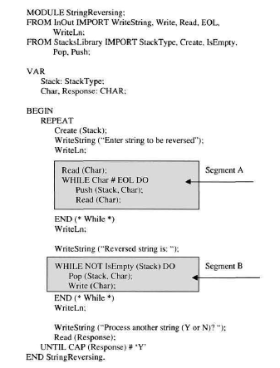
Example: A string reversing program

Slide 75
4.PRODUCT ENVIRONMENT RELATION
To ascertain how changes in the product's environment affect the product and its underlying programs
A product is a software system.
An environment is the totality of all conditions and influences which act from outside upon the product.
example
business rules, government regulations, work patterns, software and hardware operating platforms. It is essential for the maintenance personnel to know not only the nature but the extent of the relation.
Notes:
Ascertain - determine

Slide 76
5.Decision support features
To support technical and management decision-making processes
Software product attributes such as complexity and maintainability are examples that can guide maintenance personnel in technical and management decision-making processes like option analysis, decision-making, budgeting and resource allocation.
Measures of the complexity of the system can be used to determine which components of the system require more resource for testing. The maintainability of the system may be used as an indicator of its quality.
Reverse engineering can be used to study the system to be understood in order to extract these kinds of information.

Slide 77
Through many factors, the maintenance personnel can acquire the above categories of knowledge about a system.
These include comprehension strategies, domain expertise, quality of documentation, presentation and organization, programming practice and implementation issues, and support tools.

Slide 78
Maintainers and Their Information Needs
Members of the maintenance team -managers, analysts, designers and programmers – all have different comprehension or information needs depending on the level at which they function.

Slide 79
1. Managers
Managers need to have decision-support knowledge to make informed decisions. The level of understanding required will depend on the decision to be taken
Managers do not necessarily have to know the architectural design of the system or the low-level program implementation details in order to carry out their duties.
For example, to be able to estimate the cost and duration of a major enhancement, knowledge of the size of the programs (in terms of lines of code or function points) is required.

Slide 80
2. Analysts
During development the analyst requires an understanding of the problem domain(for example, finance or health care) to undertake tasks such as determining the functional and non-functional requirements, and to establish the relationship between the system and the elements of its environment.
During maintenance, the analysts concerning how changes in this environment (for example, new government regulations or a new operating system) would affect the system.
Thus the analysts need to have a global view of the system and determine implications of change on the performance of a system.
Notes:
The use of physical models such as context diagrams can be employed to represent the main components of the system and how they relate to the system's environment, thereby assisting the analyst to gain a good understanding of the system without being distracted by low-level design or coding details.

Slide 81
3. Designers
The design process of a software system can take place at two levels:
architectural and detailed design
Architectural design results in the production of functional components, conceptual data structures and the interconnection between various components
Detailed design results in the detailed algorithms, data representations, data structures and interfaces between procedures or routines.
During maintenance, the designer's job is to:
- extract this information and determine how enhancements could be
accommodated by the architecture, data structures, data flow and
control flow of the existing system;
- go through the existing source code to get a rough idea of the size of
the job, the areas of the system that will be affected, and the
knowledge and skills that will be needed by the programming team
that does the job.

Slide 82
The use of concepts such as information hiding, modular program decomposition, data abstraction, object orientation, and good design notations such as data flow diagrams, control flow diagrams, structure charts and hierarchy process input/output (HIPO) charts can help the designer obtain a good understanding of the system before designing changes.

Slide 83
4. Programmers
Maintenance programmers are required to know the execution effect of the system at different levels of abstraction, the causal knowledge and knowledge of the product-environment relation.
At a higher level of abstraction (at the systems level), the programmer needs to know the function of individual components of the system and their causal relation.
At a lower level of abstraction (individual procedures or modules), the programmer needs to understand 'what each program statement does, the execution sequence (control flow), the transformational effects on the data objects (data flow), and the purpose of a set of program statements (functions)‘.

Slide 84
This information will assist the programmer in a number of ways:
1. To decide on whether to restructure or rewrite specific code segments;
2. To predict more easily any knock-on effect when making changes that are likely to affect other parts of the system;
3. To hypothesise the location and causes of error;
4. To determine the feasibility of proposed changes and notify management of any anticipated problems.
The use of tools such as static analysers, ripple effect analysers, cross-referencers and program slicers can facilitate the programmer's task.
Also experience within the given problem area, the programming task and the programming language used will determine the speed and efficiency with which the program can be understood.

Slide 85
Comprehension Process Models
Programmers vary in their ways of thinking, solving problems and choosing techniques and tools.
The three actions involved in the understanding of a program are:
reading about the program
reading its source code
and running it

Slide 86
1. Read about the program
At this stage of the process, the ‘understander' browses, peruses different sources of information such as the system documentation - specification and design documents - to develop an overview or overall understanding of the system.
Documentation aids such as structure charts and data and control flow diagrams can be used.
In large, complex and old systems (developed prior to the advent of good documentation tools, techniques and practice), this phase may be omitted if the system documentation is inaccurate, out of date or non-existent.
Notes:
Peruse – read in detail

Slide 87
2. Read the source code
During this stage, the global and local views of the program can be obtained.
The global view is used to gain a top-level understanding of the system and also to determine the scope of any knock-on effect a change might have on other parts of the system.
The local view allows programmers to focus on a specific part of the system. Information about the system's structure, data types and algorithmic patterns is obtained.
Notes:
knock-on – unplanned/secondary

Slide 88
Tools such as static analysers - used to examine source code - are employed during this phase.
They produce cross-reference lists, which indicate where different identifiers - functions, procedures, variables and constants - have been used (or called) in the program.
That way, they can highlight abnormalities (errors) in the program.
Note: System documentation may not be reliable, reading program source code is the principal way of obtaining information about a software product.

Slide 89
3. Run the program
To study the dynamic behaviour of the program
Example: executing the program and obtaining trace data
The benefit of running the program is that it can reveal some characteristics of the system which
are difficult to obtain by just reading the source code.

Slide 90
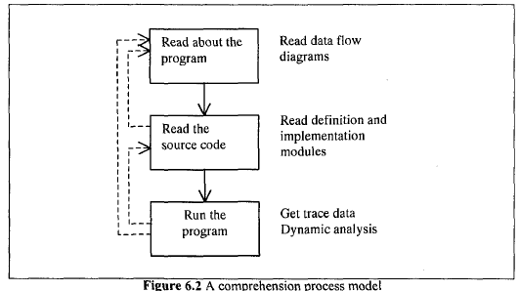
A comprehension process model - iterations of the actions and backtracking

Slide 91
Mental models
understanding of a phenomenon depends to some extent on our ability to form a mental representation, which serves as a working model of the phenomenon to be understood
The phenomenon (how a television set works, the behaviour of liquids, an algorithm) is known as the target system, and its mental representation is called a mental model
The content and formation of mental models hinges(turning point) on cognitive structures and cognitive processes
Notes:
Example: Mental models can predict behaviour such as what will happen when the television set is turned on or when a different channel is selected. Can also explain certain observations such as the occurrence of a distorted image.
A technician, who services the set in the event of breakdown needs a deeper understanding of how the set works and thus requires a more elaborate and accurate mental model.

Slide 92
Example
Understand how a television works, then you have a mental model which represents this and, based on that model, you can predict behaviour such as what will happen when the television set is turned on or when a different channel is selected.
In the case of the television set, an ordinary user - who uses it solely for entertainment - does not have to understand the internal composition of the cathode ray tube and circuits and how they work, in order to be able to use it
A technician, however, who services the set in the event of breakdown needs a deeper understanding of how the set works and thus requires a more elaborate and accurate mental model

Slide 93
The mental model is formed after observation, inference or interaction with the target system. It changes continuously as more information about the target system is acquired. Its completeness and correctness can be influenced by factors such as the user's previous experience with similar systems and technical background.
The mental model may contain insufficient, contradictory or unnecessary information about the target system. But it has to convey key informtion about the target system.
Example: if it models a piece of software, it should at least embody the functionality of the software.

Slide 94
Program Comprehension Strategies
A technique used to form a mental model of the target program.
The mental model is constructed by combining information contained in the source code and documentation with the assistance of the expertise and domain knowledge that the programmer brings to the task.

Slide 95
Program Understanding strategies
There are strategies that could be used to effectively form a mental model for the members of the team based on the results of empirical studies of programmers. These strategies are
Top-down approach
Bottom-up/chunking approach, and
Opportunistic approach

Slide 96
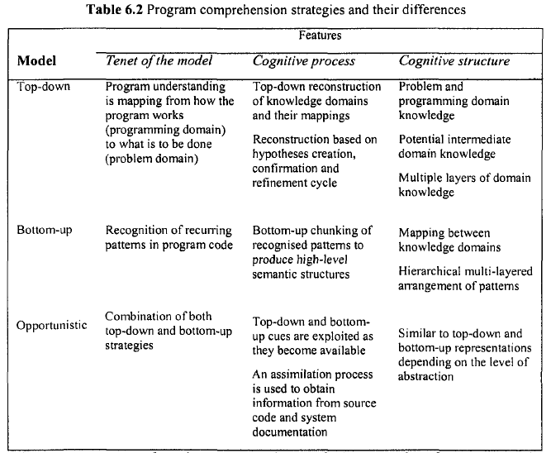
Program comprehension strategies

Slide 97
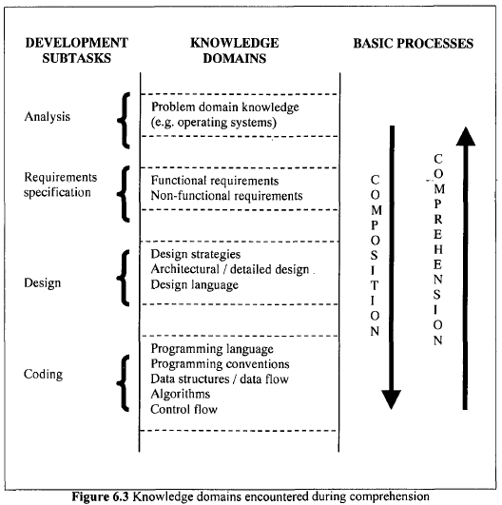
Composition represents production of a design and Comprehension is understanding that design.

Slide 98
Top-down approach
start with the most abstract problem domain concepts and attempt to map them onto the source code
Tries to reconstruct the mappings from the problem domain into the programming domain that were made during the development of the system:

Slide 99
Programmer creates assumptions or hypotheses based on both acquired or existing knowledge to arrive at an understanding
Hypotheses are checked against the source code to prove their validity
An example of a high level hypothesis is: “This program produces invoices.” This hypothesis maps the task domain (invoicing), to the programming domain (the program itself).

Slide 100
Bottom-up Approach
focus on understanding the behavior of small pieces of code and later combining this information into larger abstractions
Typically used when unfamiliar with code/application
Look for recognizable idioms within the code

Slide 101
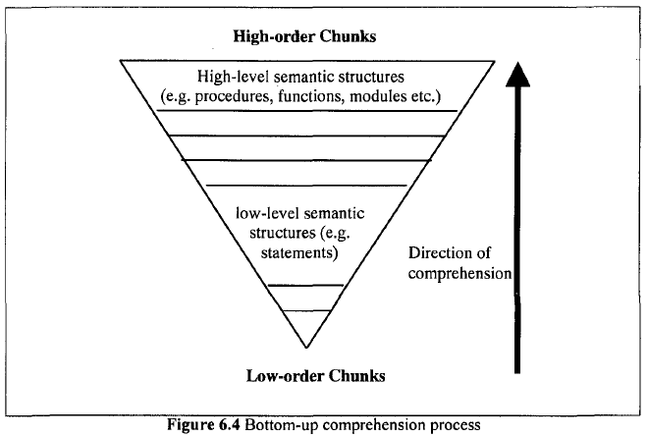
Bottom-up comprehension process

Slide 102
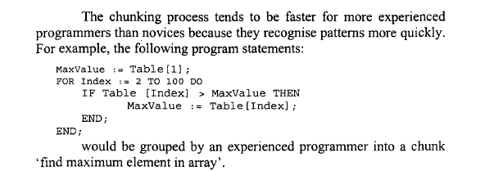

Slide 103
E.g. the “swap” idiom
t := x; x := y; y := t;
E.g. the “accumulation” pattern:
while F (i) do
total := total + A[i];
i := i + 1 do;
Combine recognized units to understand ever larger sections of code: eg recognize that the “swap” is part of a “sort” process

Slide 104
The main weaknesses of both the top-down and bottom-up strategies are:
failure to take into consideration the contribution that other factors such as the available support tools make to understanding; and
the process of understanding a program rarely takes place in such a well-defined fashion as these models portray.
Notes:
Portray - determine

Slide 105
Opportunistic Approach
The programmer/maintainer switches between Top-down and Bottom-up during the comprehension process. The switching depends on the initial knowledge.
Programmers frequently change between top-down and bottom-up approaches
E.g. Begin with top-down, gain an overview of the functions of the program

Slide 106
Opportunistic Approach
Then selectively apply bottom-up strategies when nearing code level
Use the information derived from bottom-up analysis to verify the hypotheses resulting from top-down reading

Slide 107
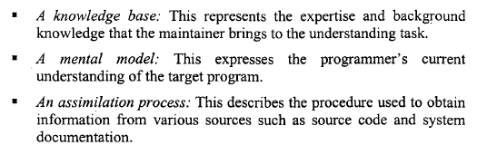
Opportunistic Approach

Slide 108
From Studying Real Programmers
The maintenance programmer needs answer to seven basic questions [Erdos/Sneed]:
1. Where is a particular subroutine or procedure invoked?
2. What are the arguments and results of a particular function?
3. How does the flow of control reach a particular location?
4. Where is a particular variable set, used or queried?
5. Where is a particular variable declared?
6. Where is a particular data object accessed, i.e. created, read, updated, or deleted?
7. What are the inputs and outputs of a particular module?

Slide 109
Program Comprehension
Program Comprehension is the process of developing mental models of a software systems intended architecture, meaning, and behavior
During maintenance and evolution, software engineers spend 60-90% of their time on program understanding

Slide 110
Goals of Program Comprehension
Program Comprehension aims to recover high-level information about a system including:
Its structure (components and their interrelationships)
Its functionality (what operations are performed on what components)
Its dynamic behavior (how input is transformed to output)
Its rationale (how was the design process and what decisions have been taken)

Slide 111
Goals of Program Comprehension
Program Comprehension aims to recover high-level information about a system including:
Its structure (components and their interrelationships)
Its functionality (what operations are performed on what components)
Its dynamic behavior (how input is transformed to output)
Its rationale (how was the design process and what decisions have been taken)
Its construction, modules, documentation, and test suites Program Comprehension does not change the subject system, nor create a new system. It is the process of examining and understanding the object system.

Slide 112
Factors that Affect Understanding
A number of factors can affect not only the formation of mental models of a program, but also their accuracy, correctness and completeness. These factors include:
expertise
programming practice and implementation issues
Documentation
program organisation and presentation
support tools
evolving requirements.

Slide 113
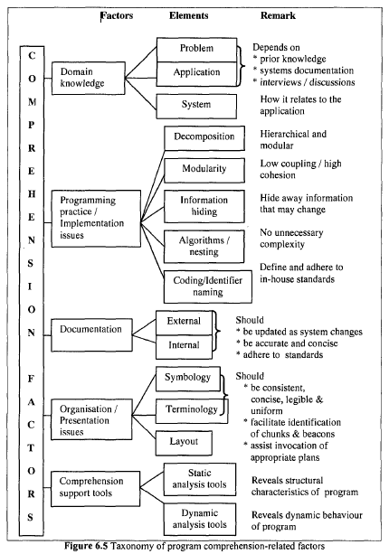
Program Understanding

Slide 114
1. Expertise
Programmers become experts in a particular application domain or a programming language by virtue of the range of knowledge and skills they acquire from working in the domain or with the language.
"Experts differ from novices in both their breadth and their organisation of knowledge: experts store information in larger chunks organised in terms of underlying abstractions. This organisation apparently facilitates quick recognition of problem types and recall of associated solution strategies.“ – Petre
more experienced a programmer - easier and quicker to understand a program

Slide 115
2. Implementation Issues
The inherent complexity of the original problem being solved by the program is a factor.
At the program level, the naming style, comments, level of nesting, clarity, readability, simplicity, decomposition mechanism, information hiding and coding standards can affect comprehension.
(i) Naming Style - Identifiers are symbols used in a program to denote the names of entities such as modules, procedures, functions, types, constants and variables. Meaningful identifier – better program understanding. hinder

Slide 116
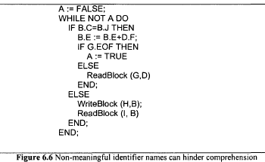
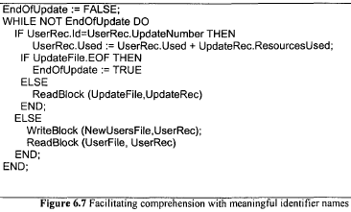
The code segment in Figure 6.6 is difficult understand. When using more meaningful
identifier names (Figure 6.7), it is easier to see that the program is performing a 'file update'.
To minimise the impact of the vocabulary problem, the identifier names should be as informative, concise and unambiguous as possible.

Slide 117
(ii) Comments – convey information about the program, such as the functionality, design decisions, assumptions, declarations, algorithms, nature of input and output data, and reminder notes.
Prologue comments precede a program or module and describe goals. In-line comments, within the program code, describe how these goals are achieved.
High-level comments (overall description of program) and low-level (description of
individual statements)

Slide 118
(iii) Decomposition Mechanism – used to deal with complexity and improve comprehensibility.
used to reduce the system into levels that can be easily handled by the human brain. Modular decomposition and structured programming can be used.
(a) Modular decomposition is a technique for dividing large software systems into manageable components - called modules – that can be easily understood
Important during design
should be done around the sources of change (areas that tend to change during the lifetime of the system )thus reducing or eliminating the ripple effect
Modularity reduces time to effect a change.
(b)Structured programming - uses high-level programming languages which aim to reduce the size and complexity of programs to manageable proportions, hence making them more readable and more easily understood.

Slide 119
3.Documentation
It is not always possible to contact the original authors of the system for information due to the high turnover of staff within the software industry.
Maintainers need to have access to the system documentation to enable them to understand the functionality, design, implementation and other issues that may be relevant for successful maintenance
The system documentation may be inaccurate, out of date or non-existent. In such cases the maintainers have to resort to documentation internal to the program source code itself - program comments.
Notes:
Resort - remedy

Slide 120
4. Organisation and Presentation of Programs
programs should be organised and presented in a manner that will facilitate perusal, browsing, visualisation and ultimately understanding.
Enhanced program presentation can improve understanding by:
facilitating a clear and correct expression of the mental model of the program and the communication of this model to a reader of the program
emphasising the control flow the program's hierarchic structure and the programmer's - logical and syntactic - intent underlying the structure;
visually enhancing the source code through the use of indentation,spacing, boxing and shading
Notes:
Perusal – read through

Slide 121
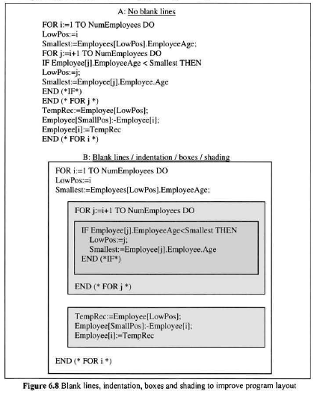

Slide 122
4. Organisation and Presentation of Programs
Indentation is used to emphasise the logical or syntactic relation between statements (or groups of statements) in a program, for example the use of indentation to group together statements belonging to a given control structure.
Spacing, using blank lines and white spaces to separate program segments or comments, can be done manually or automatically
Boxing and shading are employed to highlight the most salient aspects of a program and to indicate relationships between semantic and syntactic components of the program.

Slide 123
4. Organisation and Presentation of Programs
The use of indentation to emphasise the logical structure of a program is an example of a 'structure beacon'.
provides clues which programmers use to formulate, confirm and refine hypotheses during understanding;
provides clues that guide programmers in the invocation of suitable plans; and
promotes the formation of a program chunk. The chunk is then compared with the plans contained in the programmers' knowledge base - a repertoire of programming skills and techniques.
well-structured programs take less time to understand
program layout that facilitates the formation of mental models.
"effective program presentation makes good programs more understandable and bad programs more obvious "
Notes:
obvious - understandable

Slide 124
5.Comprehension Support Tools
Tools which can be used to organise and present source code in a way that makes it more legible, more readable and hence more understandable.
Speedup the understanding process
The output from these tools, however, does not provide explanation of the functionality of the subject system.

Slide 125
Book Paradigm
This tool is based on the 'book metaphor'.
involves documenting source code using publishing features and style traditionally found in books - sentencing, paragraphing, sectioning, pagination, chapter division, prefaces, indexing and a contents page – that facilitates comprehension.
Example: source code book for one of the ACME Health Clinic's medical information systems called Mobile Clinic. Organisation of source code promotes understanding by:
allowing programmers the freedom to use a variety of strategies and access paths that they would not normally use when reading programs;
providing high-level organisational clues about the code and low-level organisational chunks and beacons;
presenting information in a form that a programmer can easily recognise, thus expediting invocation of plans from the programmer's repertoire.

Slide 126
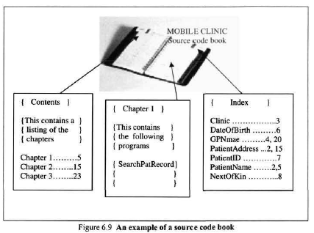

Slide 127
6.Evolving Requirements
In terms of requirements we need to think in more flexible terms:
Impact analysis is key, because changing requirements implies the addition, modification and deletion of requirements, which means that we have to introduce change as an integral part of building and maintaining systems.
Written requirements cannot be treated as though written in stone, just because they have been recorded. They will evolve.
The evolution of requirements will lead to requirements that conflict. Resolution of conflict will become a part of requirements analysis.
Requirements have always been an unofficial matter of negotiation. This will need to be recognised more formally.

Slide 128
Implications of Comprehension Theories and Studies
There is as yet no empirical evidence as to which of the program understanding strategies discussed is the best.
These activities include:
knowledge acquisition and Performance
education and training
the designing of programming languages,
maintenance tools and documentation standards; and
Issuing guidelines and making recommendations

Slide 129
1.Knowledge Acquisition and Performance
The knowledge that a maintainer requires for modifying a program depends on the nature of the change.
Example
study to investigate the relationship between the comprehension strategy used, the knowledge acquired and the programmers' performance on a modification task
The subjects who used a systematic strategy (similar to the opportunistic) were successful in making modifications because they gathered knowledge about the cause effect relation of the system's functional units.
However, the subjects who used the as-needed strategy (similar to bottom-up) failed to do the same because they did not obtain the cause-effect relation.

Slide 130
2.Education and Training
Maintainers need to be taught about program understanding
If they are aware of the different approaches they would judge which is the most suitable one for a given task and environment.
They can also reflect on the appropriateness of the strategy that they usually use.
The maintainers should be allowed to work with the strategies with which they feel comfortable

Slide 131
3.Design Principles
Comprehension hinges on the ability to form an accurate mental model of the target program.
Lessons can be learnt about appropriate principles for designing programs, programming languages, documentation standards and support tools that facilitate the formation of mental models
Tools developed to support comprehension should make provision for top-down, bottom-up and opportunistic models, but without imposing any of them on maintainers.

Slide 132
4.Guidelines and Recommendations
Results from empirical studies provide a basis for software maintainers to set guidelines for programming and documentation practices and choice of tools , methods and techniques.
Example
the psychological argument and empirical evidence that a modular program is better suited to maintainers' cognitive structures and cognitive processes than a non-modular program,
organisations and their personnel should take the guidelines seriously.

